Slide 1
ET0023 Operating Systems
2: Computer Systems Overview

Slide 2
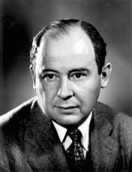
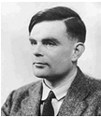
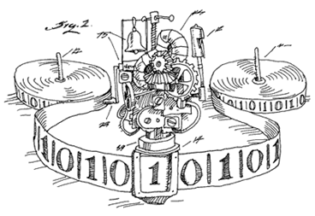
Computer System Architecture
Storage
Von Neumann 1903-1957
Alan Turing
1912-1954
Processor
Input
Output
Memory
Notes:
The Turing machine, which can be considered a model of a general purpose computer.
The term Von Neumann architecture, also known as the Von Neumann model or the Princeton architecture, derives from a 1945 computer architecture description by the mathematician and early computer scientist John von Neumann and others.
The term Von Neumann architecture describes a design architecture for an electronic digital computer with subdivisions of a processing unit, a memory to store both data and instructions, external mass storage, and input and output mechanisms.

Slide 3
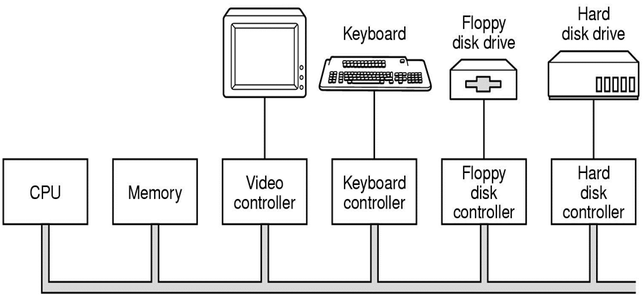
Components of a PC
Monitor
Bus
Notes:
The CPU, memory and I/O devices are all connected by a system bus and communicate with one another over the bus.
An OS is intimately tied to the hardware of the computer it runs on. It extends the computer’s instruction set and manages its resources.

Slide 4
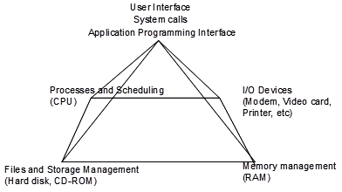
OS Pyramid
Notes:
The functions of an operating system
User Interface
Process/Job Management
Task Management
Memory Management
File Management
Device Management
Security

Slide 5
CPU with Multiple Bus System
CPU is inter-connected with the hardware with multiple bus systems.
Fast Memory Buses (Memory, Video)
Memory Controller Hub (Northbridge) handles High Speed Ops
I/O Controller Hub (Southbridge) handles Slower I/O
Medium speed interfaces for Networking, USB, Hard-disk, DVD/CD Storage
Slow speed mouse, keyboard and legacy I/O
Notes:
The CPU is inter-connected with the hardware with multiple bus systems.
Polling and Interrupt are two major I/O instruction flow control mechanism.

Slide 6
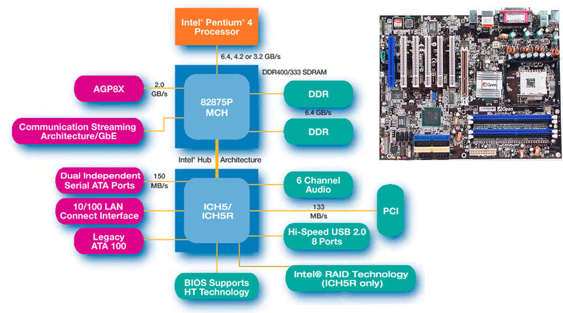
Intel P4 Hub chipset
Notes:
As processors and memories got faster, the single bus system is no longer able to cater to handle the traffic.
Various bus systems (cache, local, memory, PCI, SCSI, USB, IDE and ISA) were developed, each with a different transfer rate and function.
The memory controller hub coordinates the fast memory bus system used for the CPU-memory-AGP traffic. The I/O controller hub coordinates the medium speed I/O devices and other PCI devices Additional legacy slow speed buses were added and channelled through the IOCH.
The OS must be aware of all of these buses for configuration and management.

Slide 7
Short Quiz
Types of Computers
Mechanical
Electronic
Optical
cloud
Quantum

Slide 8
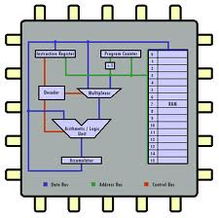
The CPU
Central Processing Unit built using VLSI
Contains ALU, Registers, Program Counter, Control.
Executes machine instructions, maintains the "heartbeat" of the system, controls operations
Driven by a clock/pulse generator
Each instruction completes in "X" clock cycles
http://courses.cs.vt.edu/csonline/MachineArchitecture/Lessons/CPU/Lesson.html
Notes:
The processing unit consisting of an arithmetic logic unit and processor registers, a control unit containing an instruction register and program counter.
Accessing memory to get an instruction or data word takes much longer than executing an instruction, CPUs contain some registers inside to hold key variables and temporary results.

Slide 9
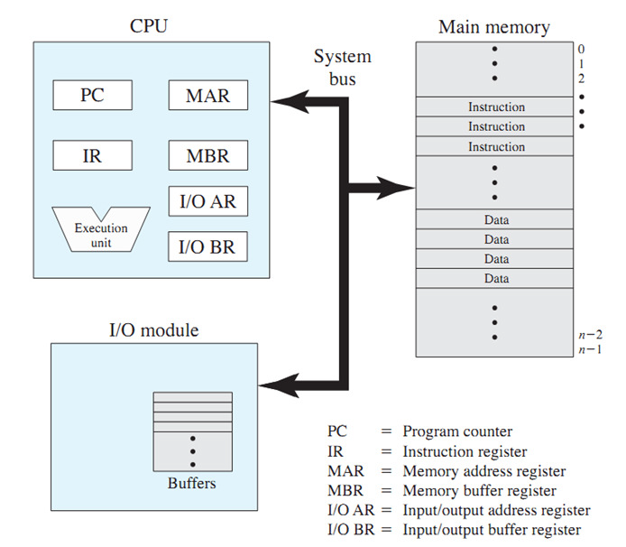
CPU Internal Structures
http://www.c-jump.com/CIS77/CPU/VonNeumann/lecture.html

Slide 10
CPU Architectures
CISC and RISC
Pipelined architectures
Superscalar
Notes:
ARM is a family of instruction set architectures for computer processors based on a reduced instruction set computing (RISC)architecture developed by British company ARM Holdings.
A RISC-based computer design approach means ARM processors require significantly fewer transistors than typical CISC x86processors in most personal computers. This approach reduces costs, heat and power use.
An instruction pipeline is a technique used in the design of computers to increase their instruction throughput (the number of instructions that can be executed in a unit of time). Pipelining does not reduce the time to complete an instruction, but increases instruction throughput by performing multiple operations in parallel.
In superscalar CPU, multiple execution units are present (eg. One for integer, one for floating-point and one for Boolean operation). Two or more instructions are fetched at once, decoded, and dumped into a holding buffer until they can be executed. Program instructions are often executed out of order.

Slide 11
Enhancing Processor Performance
Memory caching | High speed memory to speed up access peripherals and memory.
Pipelining | Method of organizing CPU circuitry to enable multiple instructions to execute simultaneously in different stages
Branch prediction and speculative execution | Ensure pipeline is kept full while executing conditional branch instructions
Multiprocessors | Duplicate CPUs or processor stages execute in parallel

Slide 12
CPU Internal structures
Address
Program Instruction Counter
Address pointers
Memory
Registers
Stack Pointer
ALU (Arithmetic Logic Unit)
Program Status Word
Notes:
Program Instruction Counter: Keeps track of the NEXT instruction to be executed
Address pointers: A register contains values that reference a memory address
General Registers: Temp storage locations for intermediate calculations
Program Status Word: contains the condition code bitsKeeps track of the arithmetic and logical operations by setting/clearing bits indicating the status of the operation
Program counter contains the memory address of the next instruction to be fetched.
Stack Pointer: Points to top of the Stack memory area. The stack memory area allows data to be PUSHed or PULled automatically using SP which increments/decrements accordingly
Stack is fast memory in the CPU. It is used largely during a function call but depending on the language and level of programming it may be used to temporarily store processor register data or other variables. Further, the stack may also be used for short-term large-scale storage of data when using recursive functions that store partial data in the stack and call themselves again.

Slide 13




Fetch Execute Cycle
CPU fetches instructions from memory, decodes and executes them
Each CPU has specific set of instructions that it can execute
CPU speed is measured based on the speed of executing instructions
Fetch
Decode
Execute
Basic CPU Instruction Cycle
Notes:
The basic cycle of CPU is to fetch the first instruction from memory, decode it t determine its type and operands, execute the instruction and then fetch, decode and execute subsequent instructions. The cycle is repeated until the program finishes.

Slide 14
General Processor Block Diagram
Fetch
Instruction cache
Dispatch
Registers
...
FP
INT
BRA
CMP
Functional Units
Data Cache
Memory
Notes:
Control unit repeats four basic operations:
Fetch - obtain program instruction or data item from memory
Decode - translate instruction into commands
Execute - carry out command
Store - write result to memory

Slide 15
Three-bus Architecture
Memory
Input / Output devices
Processor
Memory bus
Data Bus
Control Bus
Notes:
The system bus is actually a three bus architecture consists of
Memory bus: carry the addresses of memory to be accessed
Data bus: carry the actual data to be transferred
Control bus: carry the control signal to indicate the actual action to be performed (read or write)

Slide 16
1. Instruction Fetch
Memory
Processor
Memory bus
Control Bus
CPU indicates that it wants an instruction on the Control Bus
CPU outputs address for next instruction to select Memory
Notes:
In a fetch cycle, the CPU output the address for the next instruction on the memory bus
The CPU then through the control bus instruct the memory selected to release data.

Slide 17
2. Instruction Read
Memory
Processor
Data Bus
Control Bus
CPU sends a "READ" to the memory
CPU reads instruction from the memory
Notes:
CPU sends a "READ" to the memory through the control bus
The instruction given by CPU on the control bus instruct the memory selected to release data on the data bus.

Slide 18
3. Instruction Decode/Execute
Memory
Processor
What do I need
to do?
CPU decodes the instruction based on the Functional Unit/Microcode
CPU "Executes"
Perform an internal operation
Read another data
Write data
Buses are NOT used during this period
Notes:
After the processor received the data from the memory, the CPU must ‘figure out’ what to do with the instruction received.

Slide 19
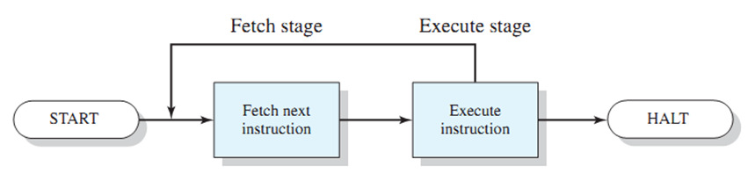
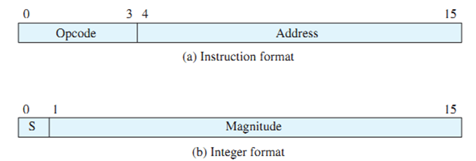
Basic Instruction Cycle
Notes:
an opcode (operation code) is the portion of a machine language instruction that specifies the operation to be performed.
Apart from the opcode itself, an instruction normally also has one or more specifiers for operands (i.e. data) on which the operation should act

Slide 20

Examples: Instruction
Intel x86 Instruction set
– JMP 300
– MOV AX, 940
– ADD AX, 941
– MOV 941, AX
– IN
http://en.wikibooks.org/wiki/X86_Assembly/X86_Family

Slide 21
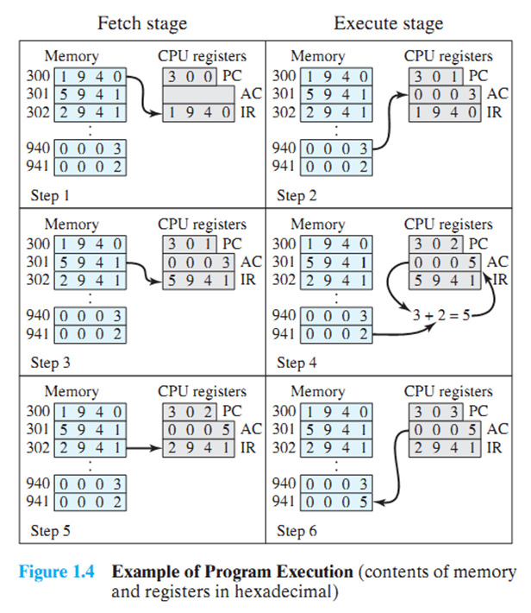
Program Execution
Operating Systems:
Internals & Design Principles
William Stallings
Notes:
Step 1: Program counter = 300, fetch the content 1940 from memory location 300 into Instruction register IR
Step 2: Program counter = 301, decode the instruction, a read operation, read content 0003 from memory location 940 into accumulator register: AC= 3
Step 3: Program counter = 301, fetch the content 5941 from memory location 301 into Instruction register IR
Step 4: Program counter = 302, decode the instruction, an add operation, add content 0002 from memory location 941 to AC: AC = 3 + 2 = 5
Step 5: Program counter = 302, fetch the content 2941 from memory location 302 into Instruction register IR
Step 6: Program counter = 303, decode the instruction, a store operation, store content 0005 from AC into memory location 941.

Slide 22
Advanced CPU
Pipelined architectures
Superscalar
Multithreading or hyper-threading
Multicore chips
Shared or separate L2 caches
Graphics Processing Units
A processor with thousands of tiny cores
Notes:
A GPU is very good for many computations done in parallel, like rendering polygons in graphics applications, encryption or processing of network traffic. They are not good at serial tasks. They are also hard to program.

Slide 23
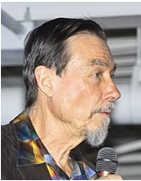
Memory Hierarchy
Typical access time
Typical capacity
.2 nsec
Register
<1 KB
1 nsec
Cache
4 MB
5 nsec
Main Memory DDR
512 MB – 32 GB
10 usec
SSD Flash Drive
50 GB – 500 GB
10 msec
Magnetic Disk HDD
500 GB – 4 TB
100 msec
Magnetic Tape
500 GB – 4 TB
What is the cost per GB for a typical 1TB HDD?
Prof. Carver A. Mead:
Moore's Law: The amount of transistors that can be placed on the same amount of silicon doubles every two years.
Notes:
Ideally, memory should be extremely fast, abundantly large and very cheap.
The memory system is constructed as a hierarchy of layers. The top layers have higher speed and greater cost per bit while the lower layers have larger capacity at lower cost.
Calculate and compare the dollar cost per Giga Byte of typical memory storages.
Moore's law is the observation that over the history of computing hardware, the number of transistors on integrated circuits doubles approximately every two years. This exponential improvement has dramatically enhanced the impact of digital electronics in nearly every segment of the world economy.

Slide 24
Memory
Registers
Made of same material as the CPU thus just as fast
CISC vs RISC systems
Cache Memory
High speed memory
As RAM is accessed in row format, stores row(s) of memory
Highly likelihood that next access is in the row
Cache Miss / Cache Hit
Notes:
L1 cache is always inside the CPU and usually feeds decoded instructions into the CPU’s execution engine.
L2 cache is generally larger but slower with access delay than L1 cache. L2 cache can be internal or external to the CPU unit.

Slide 25
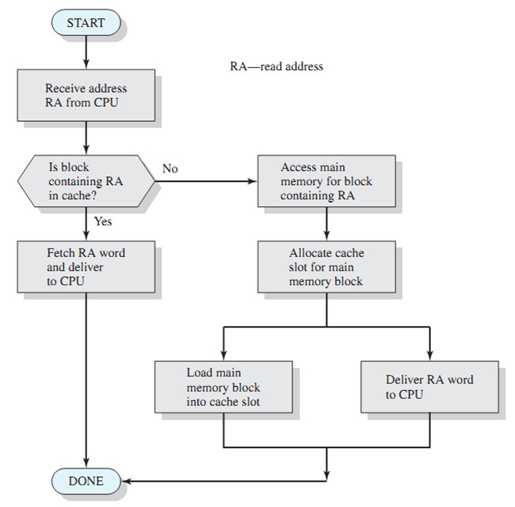
Cache Read Operations

Slide 26
Memory
RAM (Random Access Memory)
Usually dynamic/refreshed memory
Fast, large amounts of memory storage
ROM (Read Only Memory)
Stores the startup/bootstrap program of the system
Stores BIOS/System Hardware routines
EEPROM (Electrically Erasable Programmable ROM) and Flash memory
Able to be electrically erased and re-written
Allows flexibility in updating systems
CMOS memory
Holds current date and time and configuration parameters
Virtual memory
Notes:
There are two types of internal memory: RAM and ROM.
Flash memory is commonly used storage medium in portable devices. Flash memory is intermediate in speed between RAM and disk. If it is erased too many times, it wears out.
CMOS is volatile and is powered by a battery. CMOS draws so little power that the original battery can last several years.
Virtual memory gives the ability to run programmes larger than the machine’s physical memory by rapidly moving pieces back and forth between RAM and disk.
VM allowed having a program dynamically link in a library at run time instead of having it compiled in.

Slide 27
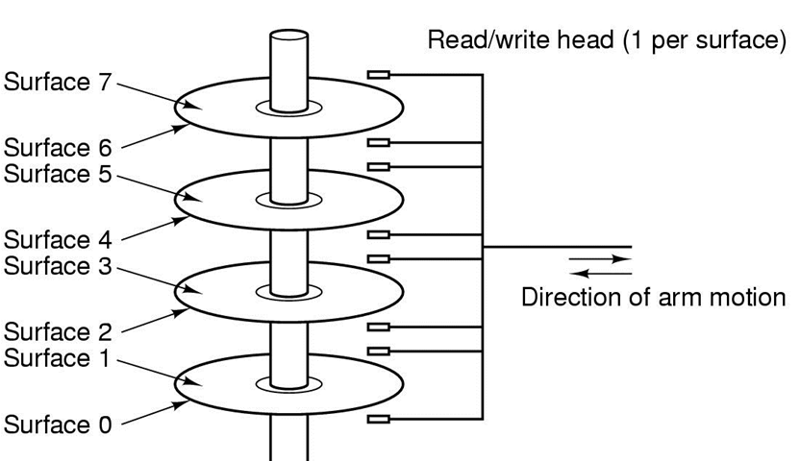
Magnetic Storage
Tracks
Sectors
Cylinders
Platters
RPMs
Access Time
Notes:
In addition to the internal memory, a computer needs external mass storages. There are 3 types of mass storage: Magnetic storage such as hard disk drive and tapes; Optical storage such as CDROM and DVD; Solid state storage such as flash drive.

Slide 28
Magnetic Storage Terms
A disk consists of one or more metal/glass platters which may be accessed on 1 or 2 surfaces.
Each platter is divided into a number of concentric tracks.
A cylinder is made up of a track on each of the platters at the same horizontal position.
Each track is divided into sectors which usually hold 512 bytes of user data.
Outside tracks (OD)may hold more information than inside tracks (ID) on a platter.
The platters spin at a high speed measured in RPM.
Seek time is the time taken for the Read/Write head to move from one track to another for information.
The amount of data that the drive can read/write per second is known as the data access rate.
Notes:
How many sectors are there in 1 Mega byte of user data?
No. of sector = 1024000 / 512 = 1000 K / 0.5 K = 2000 sectors
What is the time of one revolution of the disk for 7200 RPM drive?
No. of rev per second = 7200 / 60 = 120
time per rev = 1000 /120 ms = 8.33 ms

Slide 29
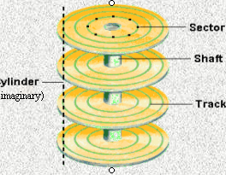
Sectors and tracks
Data is stored on the surface of a platter in sectors along the tracks.
Tracks are concentric circles on the disk.
And sectors are part portion of a track.

Slide 30
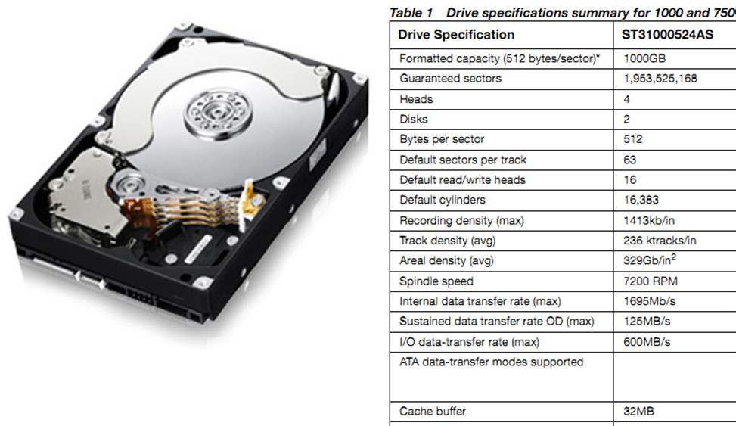
Typical Hard Disk Parameters

Slide 31
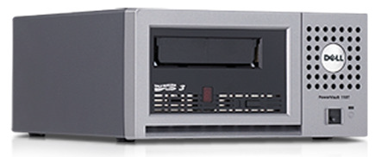
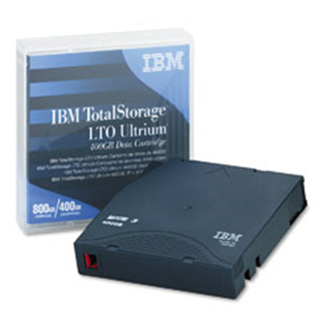
Tape Drives
Backup medium for Hard Disk storage
Holds large data sets
Full/Incremental backups
Storage is serial, may need operations to move to the correct locations
Current Technology: LTO 3/4
Capacities: 400GB-1.5TB @ 140MB/s

Slide 32
Solid State Disk
SSDs have no moving (mechanical) components.
SSDs are typically more resistant to physical shock, run silently, have lower access time, and less latency.
SSD is more expensive per unit of storage than HDDs but while the price of SSDs has continued to decline over time.
Most SSDs use NAND-based flash memory, which retains data without power.
Hybrid drives or solid state hybrid drives (SSHD) combine the features of SSDs and HDDs in the same unit.
Notes:
A solid-state drive (SSD) (also known as a solid-state disk^{[1][2][3]} or electronic disk,^{[4]} though it contains no actual disk) is a data storage device using integrated circuit assemblies as memory to store data persistently. SSD technology uses electronic interfaces compatible with traditional block input/output (I/O) hard disk drives, thus permitting simple replacement in common applications.^{[5]} Additionally, new I/O interfaces, like SATA Express, have been designed to address specific requirements of the SSD technology.
SSDs have no moving (mechanical) components. This distinguishes them from traditional electromechanical magnetic disks such as hard disk drives (HDDs) or floppy disks, which contain spinning disks and movable read/write heads.^{[6]} Compared with electromechanical disks, SSDs are typically more resistant to physical shock, run silently, have lower access time, and less latency.^{[7]} However, while the price of SSDs has continued to decline over time,^{[8]} SSDs are still roughly seven to eight times more expensive per unit of storage than HDDs.
As of 2014, most SSDs use NAND-based flash memory, which retains data without power. For applications requiring fast access, but not necessarily data persistence after power loss, SSDs may be constructed from random-access memory (RAM). Such devices may employ separate power sources, such as batteries, to maintain data after power loss.^{[5]}
Hybrid drives or solid state hybrid drives (SSHD) combine the features of SSDs and HDDs in the same unit, containing a large hard disk drive and an SSD cache to improve performance of frequently accessed data.^{[9][10][11]}

Slide 33
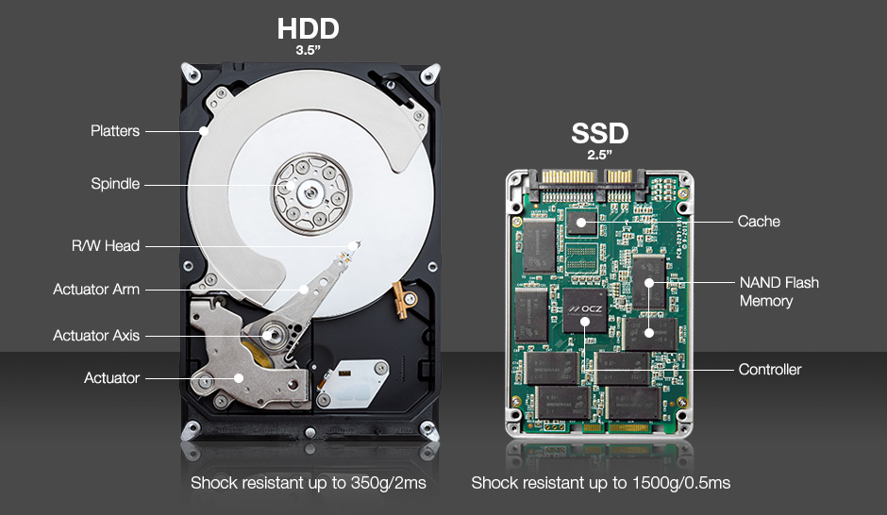
SSDs are better than HDDs?
http://ocz.com/consumer/ssd-guide/ssd-vs-hdd
Notes:
SSDs are…DURABLE
And because SSDs have no moving parts…
Hard drives consist of various moving parts making them susceptible to shock and damage, while SSDs use a non-mechanical design of NAND flash mounted on a circuit board and are shock resistant up to 1500g/0.5ms.
SSD is faster but more expensive.

Slide 34
I/O Devices
The actual device and its controller
Devices are introduced into OS by
Relink device driver with OS kernel
Make an entry in OS file and reboot system
Accept and install device driver on the fly for hot-pluggable devices.
Devices communicate with OS through
I/O mapped port space, required special commands (IN and OUT)
Memory mapped space

Slide 35
Communication with I/O Devices
Polling
Interrupt
Direct Memory Access

Slide 36
Interrupt Strategies
Interrupt request: Hardware/Software
Need to determine who has interrupted
How do we save the status?
What do we need to save?
Which Service routine do we execute?
How do we return from the service routine?
How do we restore the status?
Notes:
Hardware interrupts were introduced as a way to avoid wasting the processor's valuable time in polling loops, waiting for external events.
They may be implemented in hardware as a distinct system with control lines, or they may be integrated into the memory subsystem.
Each interrupt has its own interrupt handler. The number of hardware interrupts is limited by the number of interrupt request (IRQ) lines to the processor, but there may be hundreds of different software interrupts.

Slide 37
Polling
start
Check each device in turn for status
If service required, check the device
Keeping doing the operation
Easy to implement using software
Hard to manage priorities
Task
#1
ok?
Service #1
Task
#2
ok?
Service #2
Task
#3
ok?
Service #3
Notes:
The CPU continuously polls the devices to see if I/O devices is requesting services.
Polling or busy waiting is simple but inefficient. Polling has the disadvantage of tying up the CPU full time until all the I/O is done.
Polling is reasonable if jobs are few and short.

Slide 38
Interrupts
Normal operations progress
When device requires service, it sends a hardware request to the CPU
CPU completes current instruction
CPU saves the status of operations
CPU determines who has interrupted and services device
CPU restores old status
Instruction 1
Instruction 2
Instruction 3
Instruction 4
Instruction 5
Instruction 6
Notes:
In systems programming, an interrupt is a signal to the processor emitted by hardware or software indicating an event that needs immediate attention. An interrupt alerts the processor to a high-priority condition requiring the interruption of the current code the processor is executing, the current thread. The processor responds by suspending its current activities, saving its state, and executing a small program called an interrupt handler (or interrupt service routine, ISR) to deal with the event. This interruption is temporary, and after the interrupt handler finishes, the processor resumes execution of the previous thread.

Slide 39
Interrupts
Instruction 1
Instruction 2
Interrupt Service Routine
Interrupt
Request
Instruction 3
Service
Save status
Service
Restore status
Instruction 4
Finish
Instruction 5
Notes:
Response is fast and immediate
The CPU is not tie down when there is no interrupt. The CPU carries on with its routine until interrupt request arrives.

Slide 40
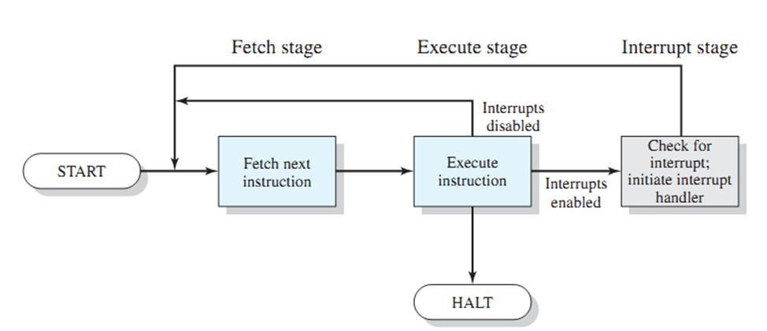
Instruction Cycle with Interrupts

Slide 41
Direct Memory Access
Allows access to the system memory without CPU intervention.
Specific hardware is used to transfer data from I/O device to Memory (DMA controller)
Advantages: Overcomes slow I/O operations from the CPU
Uses: Storage data transfers, Network transfers
Main techniques:
Cycle Stealing
Block DMA requests
Transparent mode
Notes:
Burst mode
An entire block of data is transferred in one contiguous sequence. Once the DMA controller is granted access to the system bus by the CPU, it transfers all bytes of data in the data block before releasing control of the system buses back to the CPU. This mode is useful for loading program or data files into memory, but renders the CPU inactive for relatively long periods of time. The mode is also called "Block Transfer Mode".
Cycle stealing mode
The cycle stealing mode is used in systems in which the CPU should not be disabled for the length of time needed for burst transfer modes. In the cycle stealing mode, the DMA controller obtains access to the system bus the same way as in burst mode, using BR (Bus Request) and BG (Bus Grant) signals, which are the two signals controlling the interface between the CPU and the DMA controller. However, in cycle stealing mode, after one byte of data transfer, the control of the system bus is de-asserted to the CPU via BG. It is then continually requested again via BR, transferring one byte of data per request, until the entire block of data has been transferred. By continually obtaining and releasing the control of the system bus, the DMA controller essentially interleaves instruction and data transfers. The CPU processes an instruction, then the DMA controller transfers one data value, and so on. On the one hand, the data block is not transferred as quickly in cycle stealing mode as in burst mode, but on the other hand the CPU is not idled for as long as in burst mode. Cycle stealing mode is useful for controllers that monitor data in real time.
Transparent mode
The transparent mode takes the most time to transfer a block of data, yet it is also the most efficient mode in terms of overall system performance. The DMA controller only transfers data when the CPU is performing operations that do not use the system buses. It is the primary advantage of the transparent mode that the CPU never stops executing its programs and the DMA transfer is free in terms of time. The disadvantage of the transparent mode is that the hardware needs to determine when the CPU is not using the system buses, which can be complex.

Slide 42
Normal I/O Operations
CPU
I/O Request
Control Signal
Slow!!
DO
I/O Device request
Device => CPU
CPU => Memory
WHILE more data
Data Bus
Address Bus
Memory (RAM)
Peripheral (Storage)

Slide 43
Direct Memory Access
DMA Acknowledge
CPU
DMA Request
DMA Controller
Control Signal
Data Bus
Address Bus
Memory (RAM)
Peripheral (Storage)

Slide 44
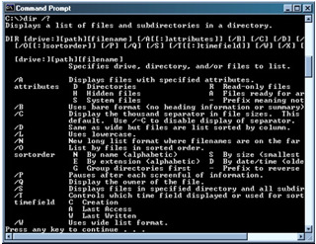
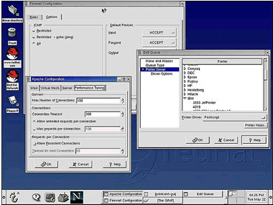
User Interface
Command Line Interface (CLI)
Command interpreter
Shells
Text input, can be scripted
Graphical User Interface (GUI)
Windows, Gnome, KDI
Heavy use of memory and I/O
Keyboard, mouse, touch

Slide 45
Advantages of User Interface
Graphical User Interface GUI
Less to learn: Controlling the GUI is far easier as the user can easily memorize movements
Intuitiveness: Selecting and moving things by dragging, clicking and scrolling across open windows is easy.
Visualization: Human is far more comfortable with pictures and spatial reasoning.
Command Line Interface CLI
Control: cli commands have options to that cater to controlling the full capabilities of the OS. Some of the Linux options are not available through the GUI
Speed: Command execution is fast in cli, launching a similar GUI program will usually take far more time.
Resources: Most GUI programs are resource hogs, take up more space on hard disk and in virtual memory.

Slide 46
Application Progg Interfaces (API)
Functions, library for usage of the interface
APIs provide libraries for
System calls, routines, transfers
Graphics
Makes development of software
Consistent with the OS
Better controlled
Easier for the programmer
Notes:
An application programming interface (API) is a protocol intended to be used as an interface by software components to communicate with each other. An API is a library that may include specification for routines, data structures, object classes, and variables.
Advantages: Consistent with the OS
Better controlled
Easier software development for the programmer
Disadvantages: Different platforms have diff programming languages
Diff programming languages have diff API

Slide 47
System Call
System Calls are used to enable user processes to interact with the kernel
Linux divides virtual address space into two parts
Kernel space and user space (architecture dependent)
User space cannot access kernel space.
Process running in user space are offered a set of interfaces to interact with the hardware and other components in the kernel space
These interface are implemented by system calls issued to the kernel
Privilege level changes during system calls to perform restricted actions such as accessing the physical hardware on the computer.
Notes:
The world length of CPU determines the maximum size of the address space that can be managed
32 bit system can address 2**32 or 4 GB address
64 bit system can address 2**64 or 4 GB x 4 GB address
The maximum size of the address space is not related to the physical RAM on the computer
It is known as the virtual address space
Process management systems calls can be use to create new tasks
Signal systems calls can send signals and timers.

Slide 48
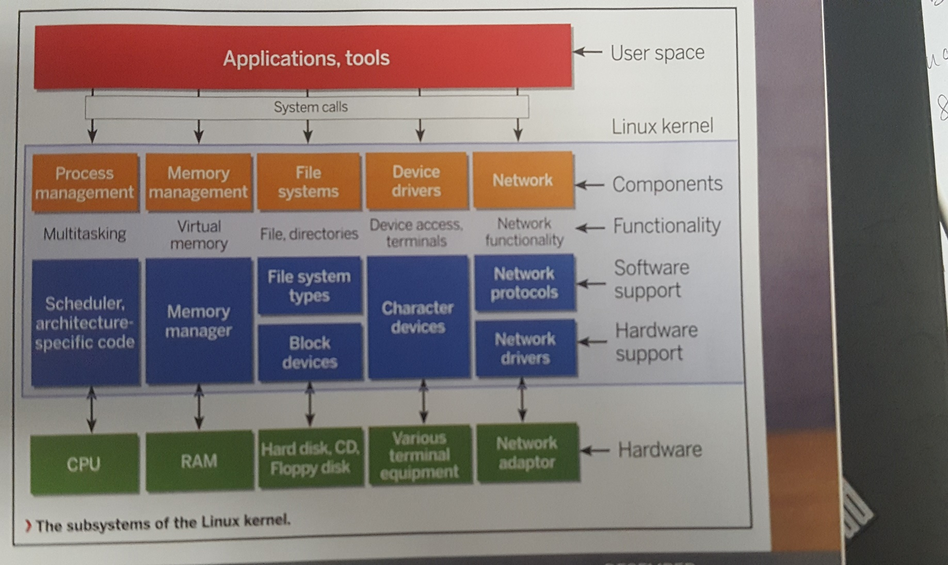
Linux Kernel’s Architecture

Slide 49
Linux Kernel Subsystems
Process management
Memory management
Virtual filesystems
Network stack
Modules and device drivers
Notes:
Process management – Control access to CPU by multiple processes
Memory management – manage memory efficiently
Virtual filesystems –supports disk-based fs (ext3/4, FAT32, NTFS), virtual fs (/proc) and network fs (CIFS, NFS).
- include a layer Virtual File System (VFS) between user processes and the filesystems implementation. The VFS layer provides abstract data structures to represent files and inodes.
Network stack - allows Linux systems to connect to other computes over a network
Modules and device drivers – Linux is a monolithic kernel, it is one large program (microkernel breaks up the functional components into separate chunks of code)
- allows dynamically loading and unloading of modules, keep kernel flexible and helps to reduce size of kernel.

Slide 50
OS Pyramid
Notes:
The functions of an operating system
User Interface
Process/Job Management
Task Management
Memory Management
File Management
Device Management
Security

Slide 51
QUESTIONS

